Slide 1
Sentiment analysis of reviews using LLMs
Sayani Boral | Jonathan Jacobs | Bazham Khanatayev

Slide 2

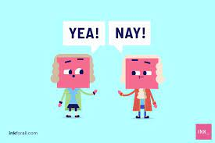
Sentiment Analysis using LLM
Project type
Research
What will you do?
Use LLM models like BERT /LLama-2 for identifying sentiments in product reviews
Compare performance of LLMs for this task vs using traditional methods
Dataset
Walmart product review dataset (https://data.world/opensnippets/walmart-products-reviews-dataset)
Why is this cool?
Get hands-on experience on GenAI techniques

Slide 3
Background & Use Case
What’s your application?
A streamlined interface for retailers to analyze customer feedback and refine product offerings. It supports searching and filtering by categories, brands, and ratings, enabling insights into customer preferences and sentiment.
What use case are you trying to solve?
Independent retailers, constrained by logistics and storage, can outmaneuver larger competitors by leveraging this application. It uses customer reviews from these competitors to identify trending products, enabling small businesses to optimize inventory strategically. This approach turns logistical challenges into a competitive advantage, facilitating informed decisions to stay ahead in the market.
What about it needs a Python library?
Textblob: Simplifies text processing and sentiment analysis, ideal for quick insights into customer reviews.
Transformers (by Hugging Face): Provides advanced natural language processing for deep sentiment analysis and nuanced feedback understanding.
LlAMA (from META): Offers detailed sentiment analysis with deep learning, enriching customer opinion insights.
Standard data manipulation and visualization such as Pandas, Matplotlib, and Seaborn
Notes:
SPEAKER - Jonathan

Slide 4

Background & Use Case
What’s your application?
A streamlined interface for retailers to analyze customer feedback and refine product offerings. It supports searching and filtering by categories, brands, and ratings, enabling insights into customer preferences and sentiment.
What use case are you trying to solve?
Independent retailers, constrained by logistics and storage, can outmaneuver larger competitors by leveraging this application. It uses customer reviews from these competitors to identify trending products, enabling small businesses to optimize inventory strategically. This approach turns logistical challenges into a competitive advantage, facilitating informed decisions to stay ahead in the market.
Notes:
SPEAKER - Jonathan

Slide 5
Python Package Nominations
Package Name | TextBlob | Transformers (default model) | Transformers (Llama 2 model)
Authored By | Steven Loria and contributors. | Hugging Face | HuggingFace + Meta
What does it do? | Python library for processing textual data , provides a consistent API for diving into common natural language processing (NLP) tasks such as sentiment analysis. Think of it as a gentler introduction to natural language processing, making it easier to figure out what people are saying in their reviews. | This library is designed to simplify the process of taking raw text input in the form of prompts and produce outputs like text generation or sentiment classification using minimal set up. This uses the default model and tokenizer suitable for whatever task you have chosen. | Powerful library for sentiment analysis, offering various pre-trained LLM models (like Llama2, BERT, OpenAI - GPT-2) to analyze the emotional tone of text data. Models demonstrate zero- or few-shot learning. This means the model can solve tasks it wasn’t explicitly trained to do.
Notes:
SPEAKER - BAZ
1. **TextBlob** **Author**: Steven Loria and contributors.
What It Does: This is a library for processing textual data. It's pretty straightforward and great for diving into NLP tasks like sentiment analysis. Think of it as a gentler introduction to natural language processing, making it easier to figure out what people are saying in their reviews.
2. **Scikit-learn Author:** Scikit-learn developers, a part of the larger SciPy community.
What It Does: While not solely for NLP, scikit-learn is your toolbox for machine learning in Python. It's got algorithms for classification, regression, clustering, and more. Perfect for when you need to categorize sentiments or predict which products will be hits.
3. **Transformers (by Hugging Face) Author:** Hugging Face, Inc.
What It Does: This library is a treasure trove for anyone looking to use state-of-the-art NLP models like GPT-3, GPT-4, and BERT, LLama2 variants. It's designed to make cutting-edge language models accessible, allowing for deep sentiment analysis and more nuanced understanding of customer feedback.

Slide 6
Comparisons Continued…
Package Name | TextBlob | Transformers (default model) | Transformers (Llama 2 model)
Features | Quick & easy Lightweight Your data is NOT shared | State of art Open model, no need to request access to a closed model Your data is potentially shared | State of art Model with guardrails in place Large scale model Your data is potentially shared
Notes:
SPEAKER - BAZ
1. **TextBlob** **Author**: Steven Loria and contributors.
What It Does: This is a library for processing textual data. It's pretty straightforward and great for diving into NLP tasks like sentiment analysis. Think of it as a gentler introduction to natural language processing, making it easier to figure out what people are saying in their reviews.
2. **Scikit-learn Author:** Scikit-learn developers, a part of the larger SciPy community.
What It Does: While not solely for NLP, scikit-learn is your toolbox for machine learning in Python. It's got algorithms for classification, regression, clustering, and more. Perfect for when you need to categorize sentiments or predict which products will be hits.
3. **Transformers (by Hugging Face) Author:** Hugging Face, Inc.
What It Does: This library is a treasure trove for anyone looking to use state-of-the-art NLP models like GPT-3, GPT-4, and BERT, LLama2 variants. It's designed to make cutting-edge language models accessible, allowing for deep sentiment analysis and more nuanced understanding of customer feedback.

Slide 7
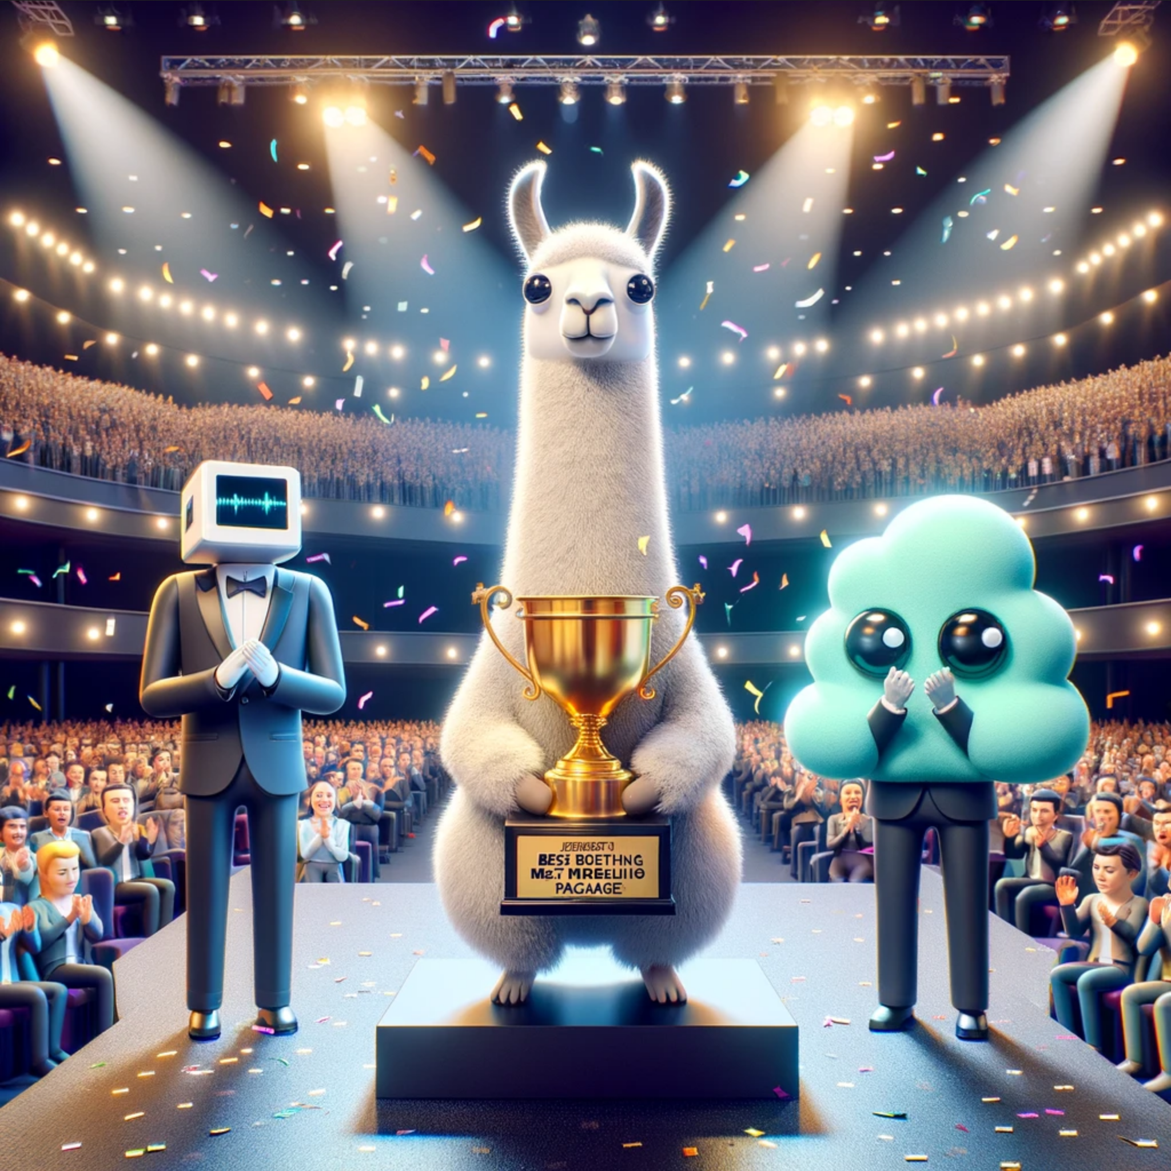
And The Chosen Package
We will be using Hugging Face Transformers package and loading model Llama-2-7b-hf
https://huggingface.co/meta-llama/Llama-2-7b-hf
Scale: LLaMA models come in various sizes, with billions of parameters, enabling them to capture a wide range of language nuances and knowledge.
Versatility: They can be applied to multiple NLP tasks without needing task-specific training for each new application.
Understanding and Generation: Capable of both interpreting input text and generating coherent and contextually relevant responses or new text.
Notes:
SPEAKER - Sayani

Slide 8
Drawbacks/Remaining Concerns
● Is there anything in the “con” list to be concerned about?
Privacy
Lack of consistency - model responses are based on how good the user prompts are + the models can hallucinate.
● Will you have to mitigate any drawbacks?
Privacy - The dataset is from opensource from Amazon , so issues around data privacy are addressed.
Hallucination / prompt engineering practices - we are using templated prompts and even plan to have a drop down in the UI where retailers can choose categories or other dimensions of the product.
● What will you watch out for?
Infrastructure - Even if use a light weight model for LLM , we would GPUs . As of now mitigating that by using colab.
Performance of application
Notes:
SPEAKER - Sayani

Slide 9
Demo

Slide 10
Q & A

Slide 11
Natural Language Processing (NLP) and LLaMA (Large Language Model at Meta) represent two different concepts within the field of artificial intelligence and computational linguistics, with NLP being a broad area of study and LLaMA being a specific type of model within that area.
### Natural Language Processing (NLP)
NLP is a branch of artificial intelligence that focuses on the interaction between computers and humans through natural language. The goal of NLP is to enable computers to understand, interpret, and generate human language in a way that is both valuable and meaningful. NLP encompasses a wide range of techniques and technologies, including but not limited to:
- **Text Analysis and Understanding**: Involves parsing, semantic analysis, and sentiment analysis to understand the content and emotion in text.
- **Language Generation**: The creation of text that is coherent and contextually relevant, often used in applications like chatbots and automated content creation.
- **Speech Recognition and Generation**: Converting spoken language into text (speech-to-text) and vice versa (text-to-speech).
- **Machine Translation**: Automatically translating text or speech from one language to another.
NLP combines computational linguistics—rule-based modeling of human language—with statistical, machine learning, and deep learning models.
### LLaMA (Large Language Model at Meta)
LLaMA, on the other hand, is a specific instantiation of a technology within the NLP field, developed by Meta (formerly Facebook). It is a type of large language model that has been trained on vast amounts of text data. These models leverage deep learning techniques to understand and generate language based on the input they receive. LLaMA models are designed to perform a wide range of NLP tasks, such as text generation, summarization, translation, and question-answering, among others. The key characteristics of LLaMA include:
- **Scale**: LLaMA models come in various sizes, with billions of parameters, enabling them to capture a wide range of language nuances and knowledge.
- **Versatility**: They can be applied to multiple NLP tasks without needing task-specific training for each new application.
- **Understanding and Generation**: Capable of both interpreting input text and generating coherent and contextually relevant responses or new text.
### Key Differences
- **Scope**: NLP is the overall field of study and application, while LLaMA is a specific model developed within the context of NLP research.
- **Application**: NLP includes a broad range of techniques and models (including rule-based systems, statistical models, and neural networks), of which LLaMA is a specific example of a neural network-based approach.
- **Functionality**: NLP techniques can be specialized or general, ranging from focused applications like named entity recognition to broad applications like language understanding and generation, which LLaMA is particularly good at.
In summary, NLP is the broad field dedicated to enabling computers to understand and interact using human language, while LLaMA is a specific tool developed as part of the advancements in NLP, showcasing the capabilities of modern deep learning approaches to language understanding and generation.

Slide 12



